Slide 1
ADC
Embedded System

Slide 2
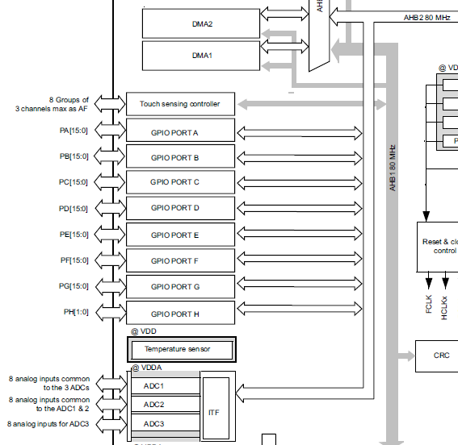
ADC - Registers
Datasheet(page 17)
ADC1 connected to APB2
Order:
Set GPIO pin to analog input
Enable clock to ADC1
Set ADC common clock
Set conversion mode
Set sequencer length and ADC channel / rank
Set ADC1 control resistor
Enable ADC

Slide 3

ADC - Registers
Datasheet(page 73)
PA4 connected to ADC1 and 2

Slide 4
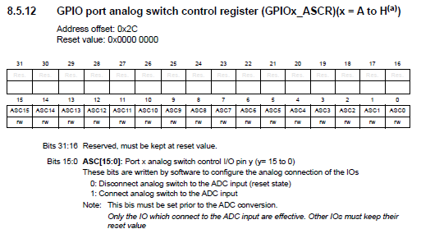
ADC - Registers
Reference manual(page 311)
Connect GPIO analog switch to ADC input
ASC4 Used from GPIOA

Slide 5
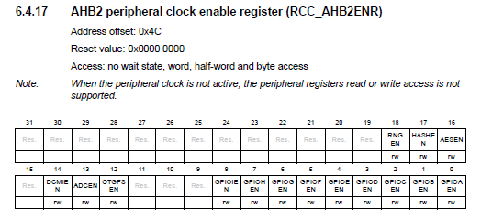

ADC - Registers
Reference manual(page 251)
Enable ADC clock from AHB2

Slide 6
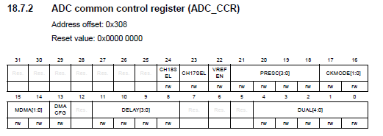
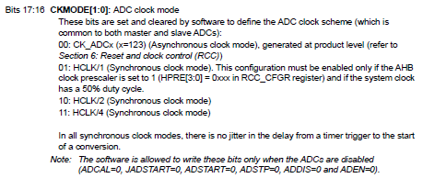
ADC - Registers
Reference manual(page 613, 614)
Set ADC common clock settings

Slide 7
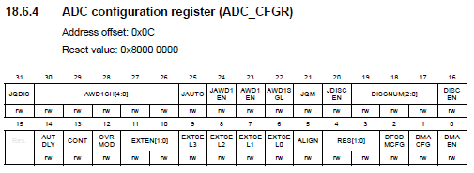
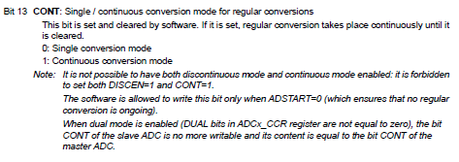
ADC - Registers
Reference manual(page 592, 594)
Set conversion mode

Slide 8
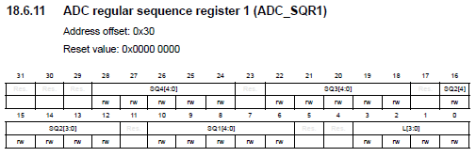
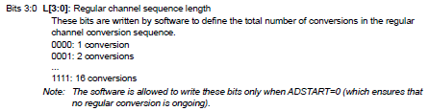

ADC - Registers
Reference manual(page 602, 603)
Set sequencer length
Set channel and rank

Slide 9
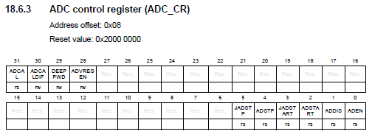

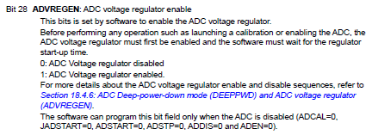
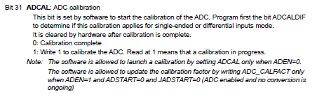
ADC - Registers
Reference manual(page 589)
Disable ADC deep power down
Enable ADC internal regulator
Start ADC calibration

Slide 10
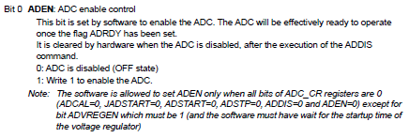
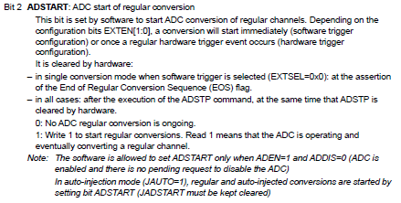
ADC - Registers
Reference manual(page 591)
Enable ADC
Start ADC conversion

Slide 11
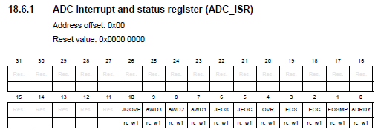

ADC - Registers
Reference manual(page 585, 586)
Check if conversion ended

Slide 12
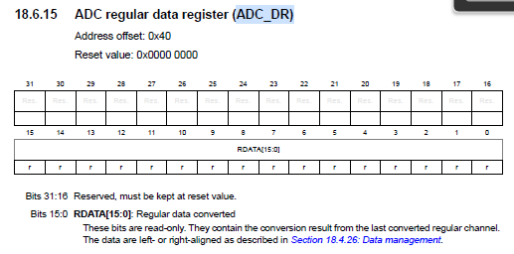
ADC - Registers
Reference manual(page 606)
Stores ADC converted data

Slide 13
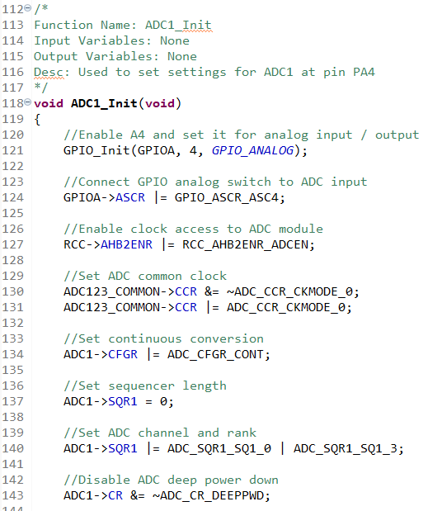
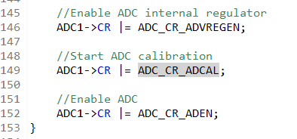
ADC1 - Continuous

Slide 14
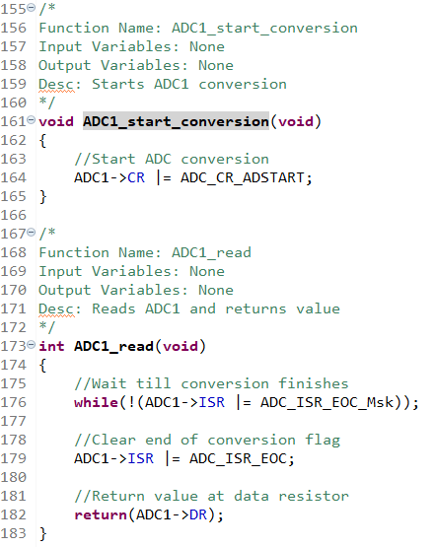
ADC1 - Continuous
Type functions to st_basic.c
Type declarations to st_basic.h

Slide 15
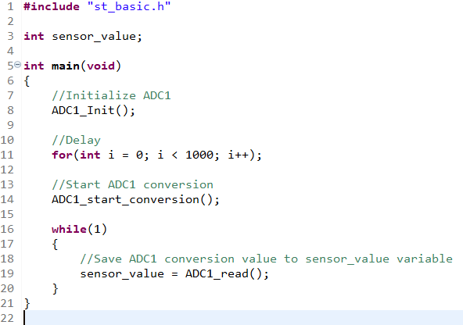
ADC1 - Continuous
After typing ‘main.c’ build code

Slide 16
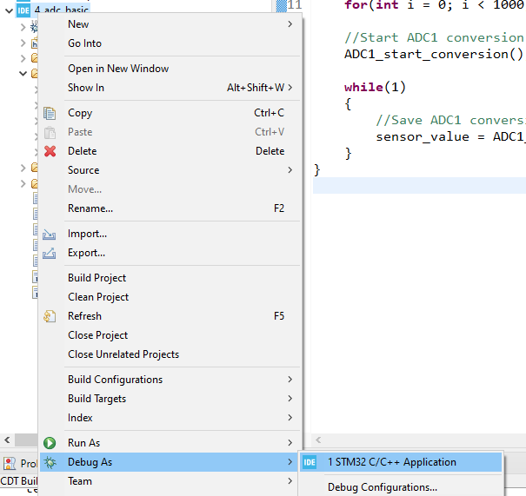
ADC1 - Continuous
Debug code
Press ‘Switch’ to ‘Confirm Perspective Switch’

Slide 17
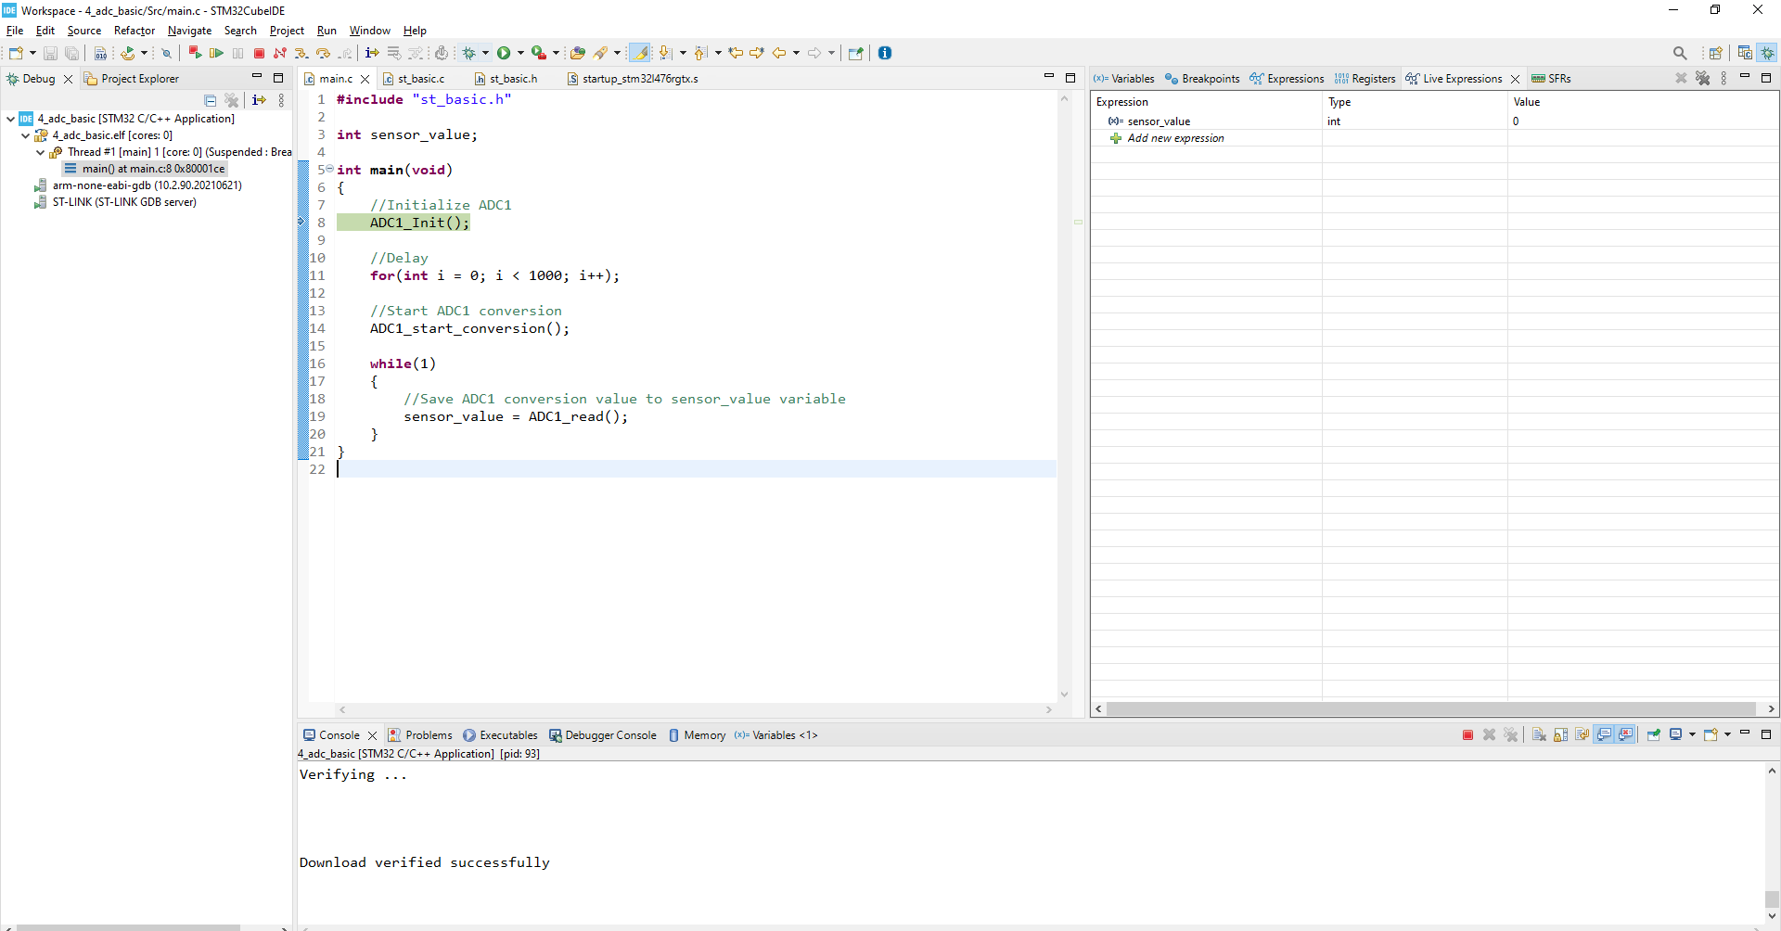
ADC1 - Continuous
This is the debugging menu
On the right window click ‘Live Expressions’ and add ‘sensor_value’ to the expression
Press F8(Resume)
Check ‘sensor_value’
Connect PA4 to GND and check value change
Connect PA4 to 3V3 and check value change

Slide 18
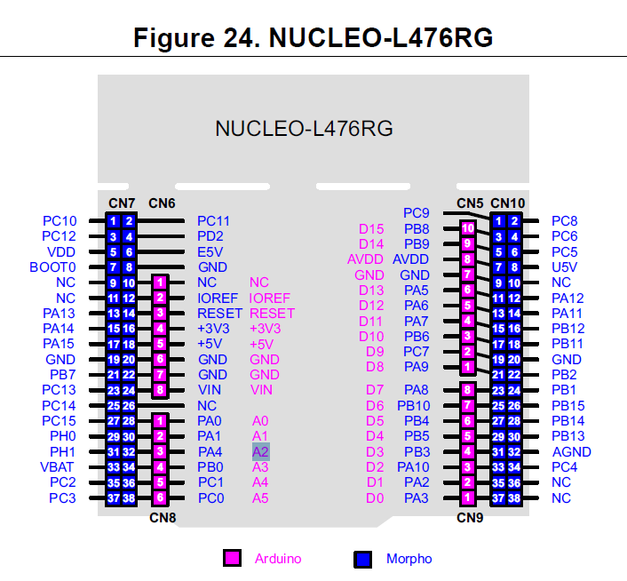
ADC1 – Not Connected
User Guide(page 35)
The PA4 pin is connected to
A2(NOT A4) at CN8 of the board
GND and 3V3 are in CN8 also

Slide 19
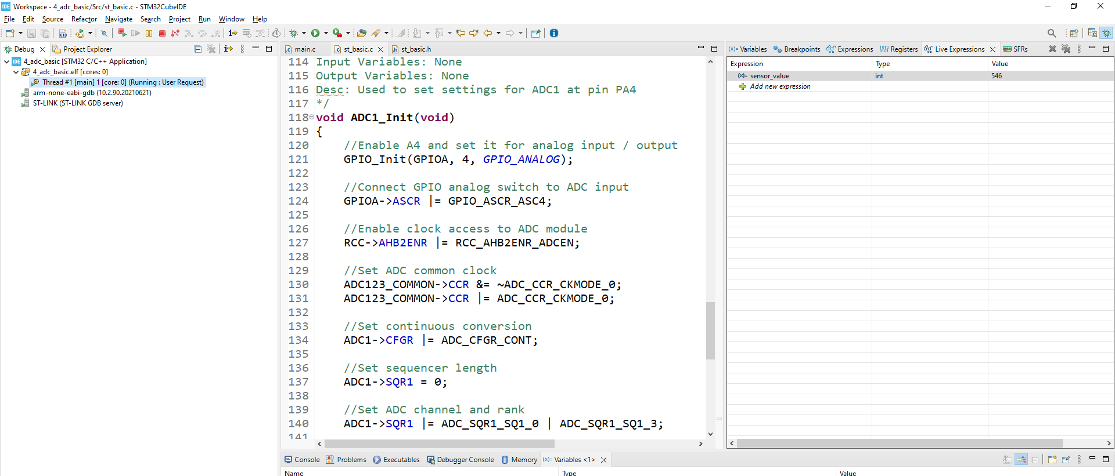
ADC1 – Not Connected

Slide 20
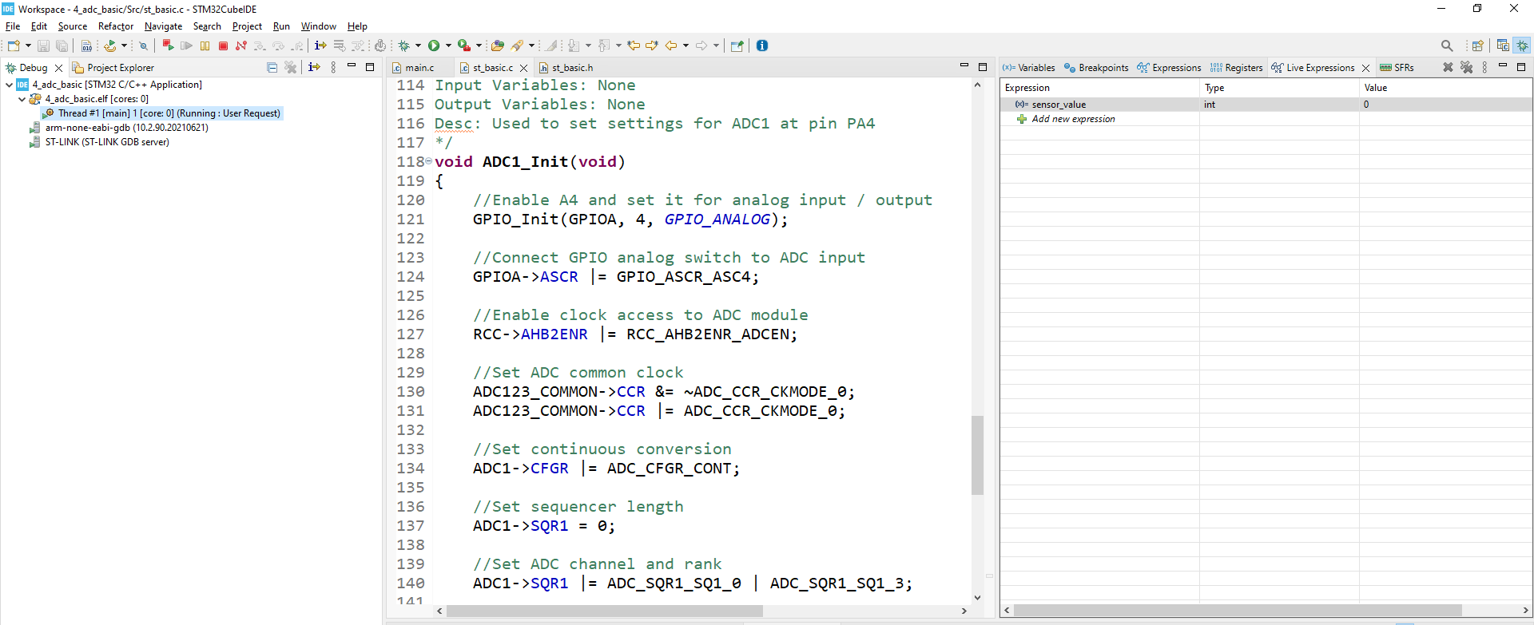
ADC1 – Connected to GND

Slide 21

ADC1 – Connected to 3V3

Slide 22
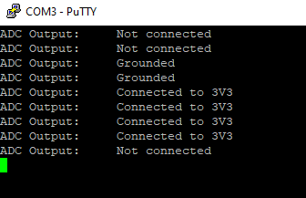
Task 1
Get input from the ADC and print where PA4 is connected to the USART using PuTTY

Slide 23

Task 2
Change the settings to get a single input from the ADC
The sensor_value never changes even if it is connected to another pin.

